Slide 1
Trigonometric ratios on a circle

Slide 2
Trigonometric Ratios
There are six trigonometric ratios: sine(sin), cosine(cos), tangent(tan), cotangent(cot), secant(sec), and cosecant(cosec/csc).

Slide 3
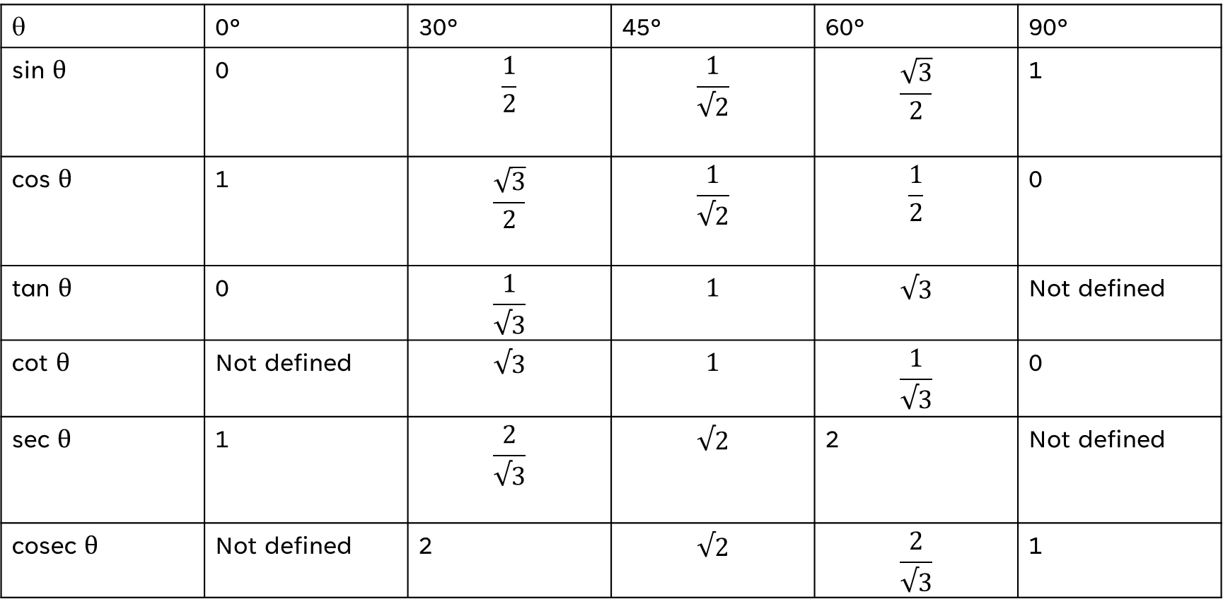
Trigonometric table
θ | 0° | 30° | 45° | 60° | 90°
sin θ | 0 | $$\frac{1}{2}$$ | $$\frac{1}{√2}$$ | $$\frac{\sqrt{3}}{2}$$ | 1
cos θ | 1 | $$\frac{\sqrt{3}}{2}$$ | $$\frac{1}{√2}$$ | $$\frac{1}{2}$$ | 0
tan θ | 0 | $$\frac{1}{√3}$$ | $$1$$ | $$√3$$ | Not defined
cot θ | Not defined | $$√3$$ | $$1$$ | $$\frac{1}{√3}$$ | 0
sec θ | 1 | $$\frac{2}{√3}$$ | $$√2$$ | 2 | Not defined
cosec θ | Not defined | 2 | $$√2$$ | $$\frac{2}{√3}$$ | 1

Slide 4
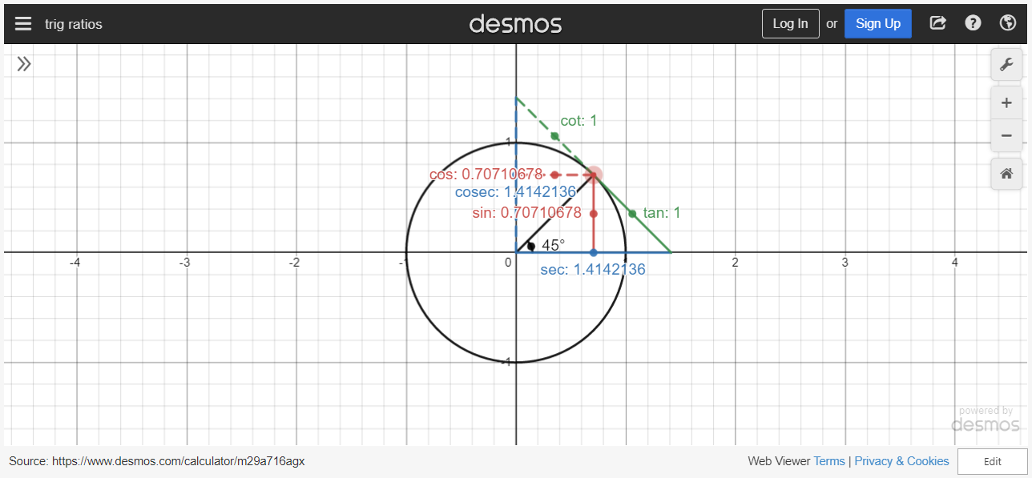
project
Project

Slide 5
THANK YOU

